Slide 1
MECHANICAL TEAM WEEK 9
Clinton Otieno

Slide 2
Tasks done
Unmounting the front wheels and axle
Motor flywheel coupling machining

Slide 3
FRONT WHEEL UNMOUNTING
This was done with an aim to extend the wheel base .
Extending the wheelbase will increase tractor balance thus reducing the tendency to roll when negotiating corners.

Slide 4
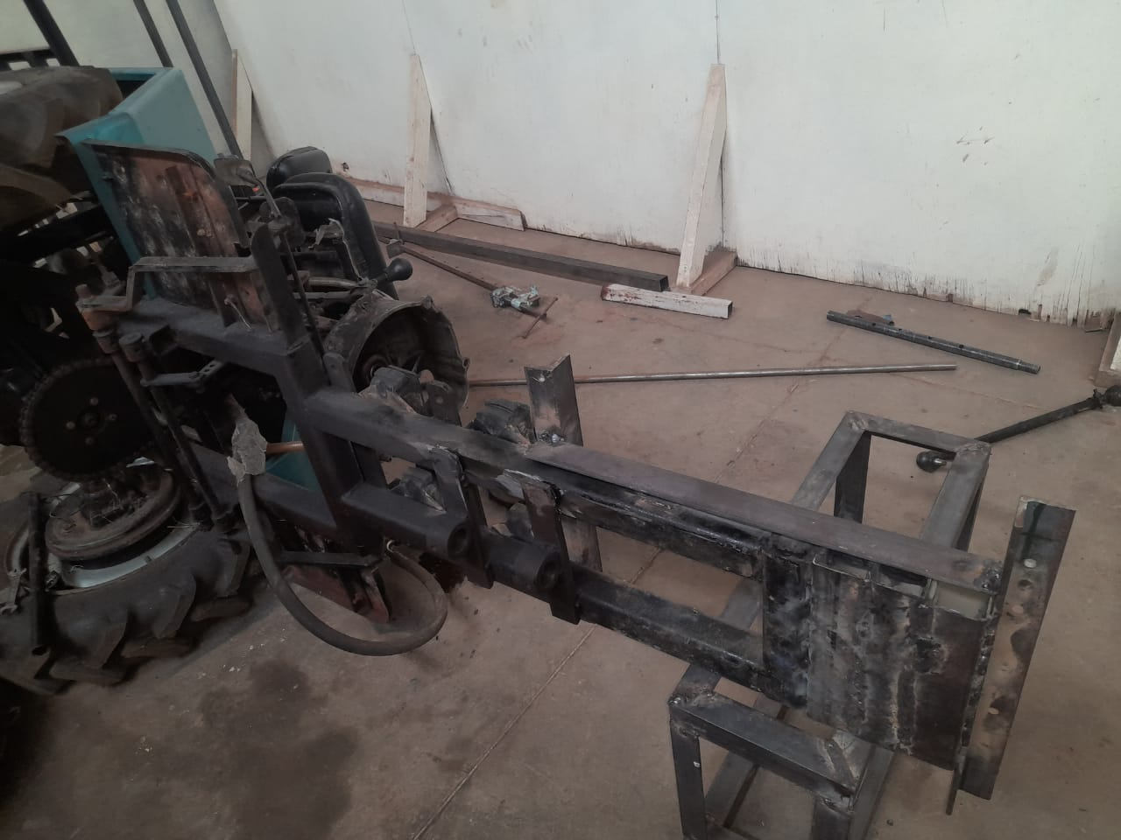
WHEEL BASE EXTENSION IN PROGRESS

Slide 5
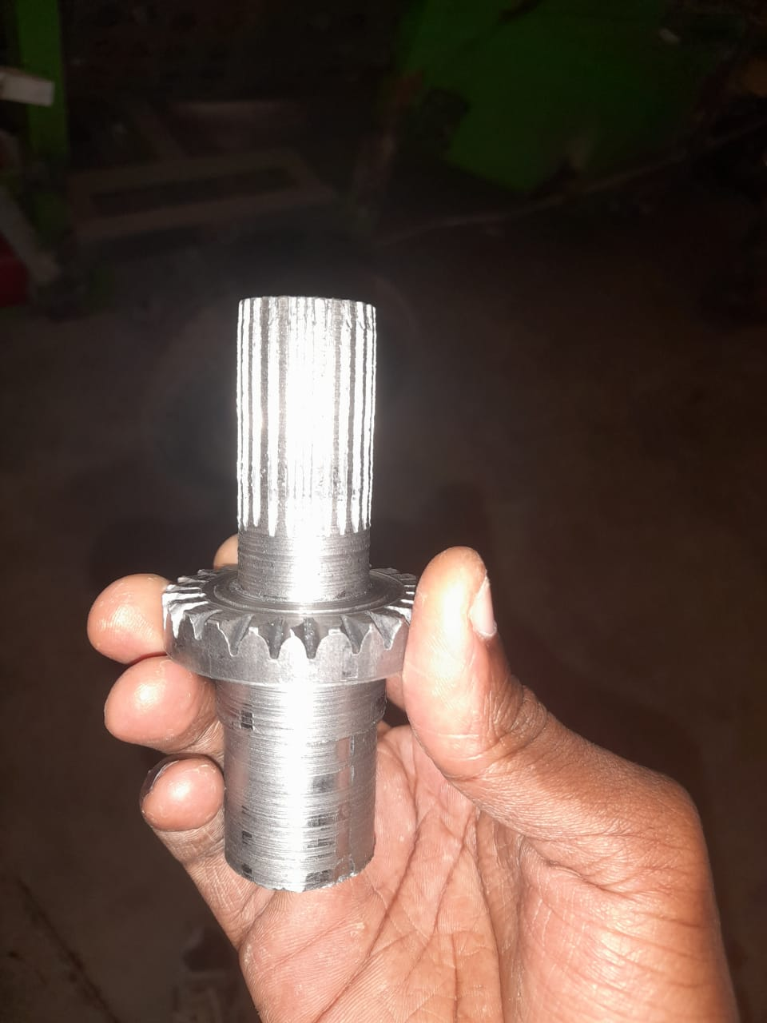
MOTOR FLYWHEEL COUPLING

Slide 6
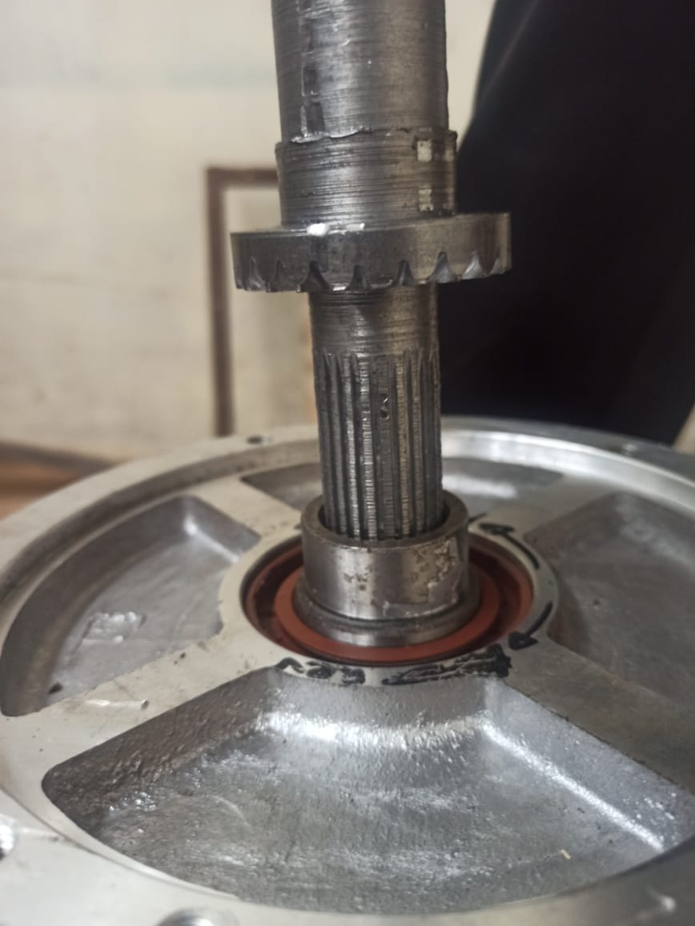
FLYWHEEL COUPLING AND MOTOR

Slide 7
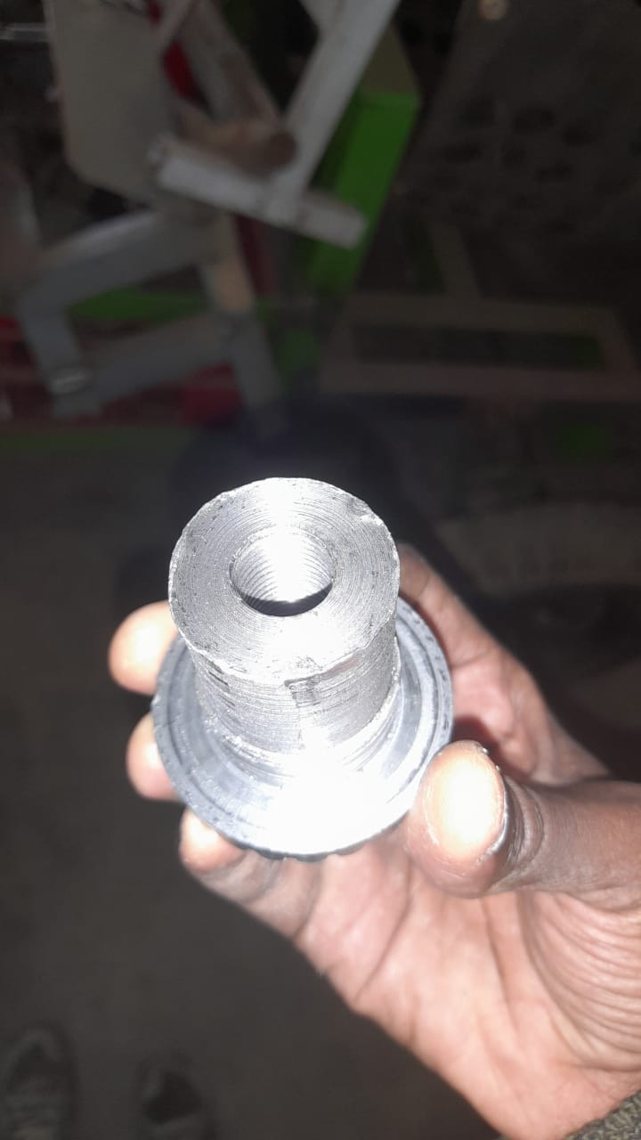
THREADED PART

Slide 8
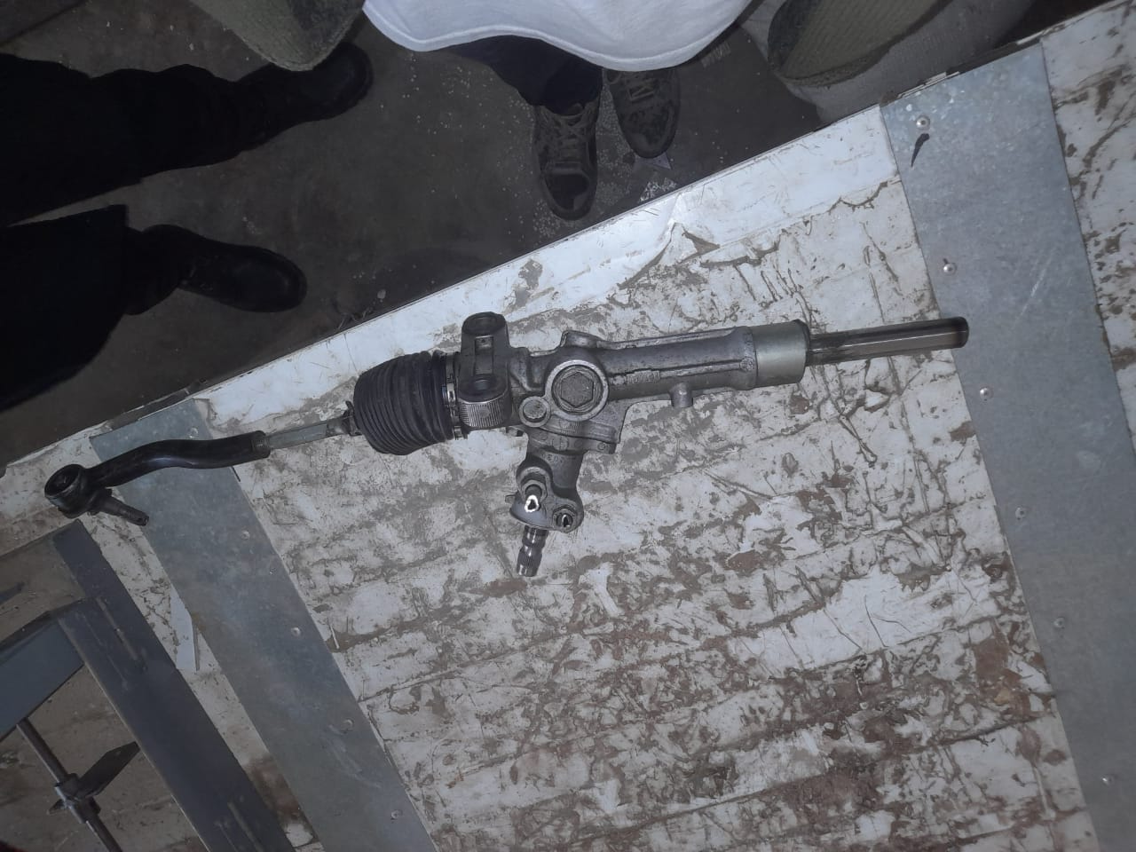
MODIFIED RACK

Slide 9
CHALLENGE
Tools acquisition

Slide 10
TO DO
Extension of wheel base
Finishing on the motor flywheel coupling fabrication
Completion of steering system fabrication

